Slide 1
//Game Development basics
CSD1400/GAM100 – week04 – Game development basics

Slide 2
Gamedev Basics
Part I
Intro
Frame
Game Loop
Part II
State machine
Rendering
Input
Movement
Interpolation

Slide 3
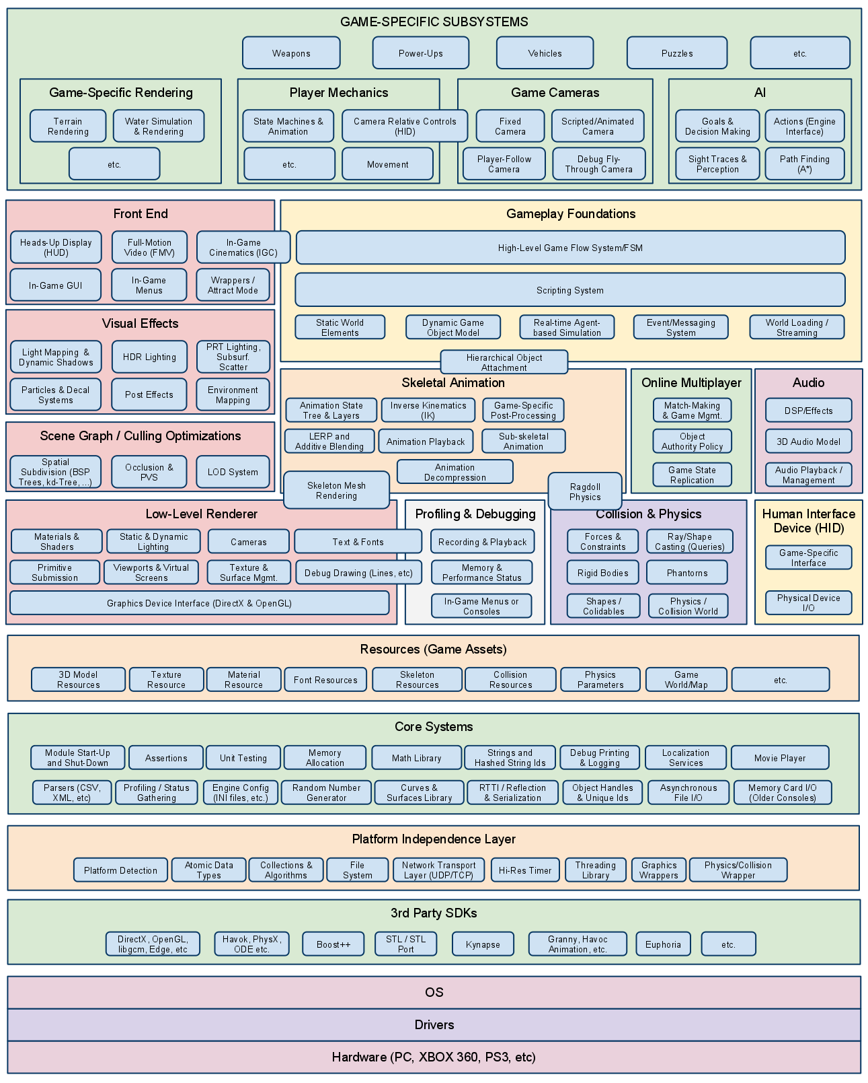
Game Engine Architecture, by Jason Gregory
Notes:
That is a game engine architecture, from a book

Slide 4
Game Engine Architecture, by Jason Gregory

Slide 5
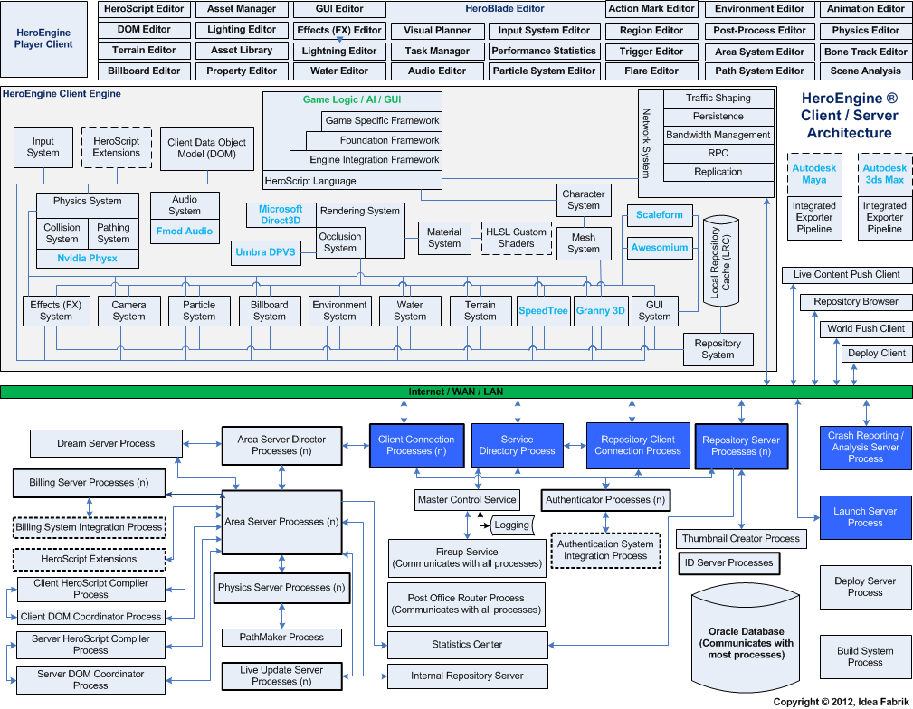
Notes:
Hero Engine architecture

Slide 6
Game engine
Can be very complicated
Many ways to develop one
We will start from the base

Slide 7
Architecture, 3 big parts
Engine – Core functionalities
File I/O / Graphics / Input / Math / Memory / Objects Management / Physics / Random / Sound
Gameplay – Rules and logic
Game logic / Actions / Enemies AI / Inventory / Power-Ups / Puzzles / Vehicles / Weapons
Editor – Data manipulation
Level / sprite / animation
Notes:
Generic, can be used to create a various number of games. Ie : Unity / Unreal
We separate the parts to make the code cleaner and easier to reuse.

Slide 8
Architecture, provided by cprocessing
Engine – Core functionalities
File I/O / Graphics / Input / Math / Memory / Objects Management / Physics / Random / Sound
Gameplay – Rules and logic
Game logic / Actions / Enemies AI / Inventory / Power-Ups / Puzzles / Vehicles / Weapons
Editor – Data manipulation
Level / sprite / animation
Notes:
Generic, can be used to create a various number of games. Ie : Unity / Unreal
We separate the parts to make the code cleaner and easier to reuse.

Slide 9
Gamedev Basics
Part I
Intro
Frame
Game Loop
Part II
State machine
Rendering
Input
Movement
interpolation

Slide 10
What is a frame
Any Video is a sequence of still images
One still image = Frame

Slide 11

Movie
Notes:
Stop motion

Slide 12

Movie
1 Frame
Notes:
Stop motion

Slide 13
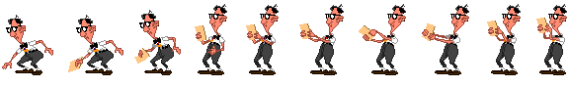
Animation

Slide 14

Animation
1 Frame

Slide 15
In videogames
We are also displaying a sequence of still images
Frames are generated in real time
Games need to react to User inputs
Notes:
In Videos, Images are recorded / captured

Slide 16
Frame per seconds
Number of still images displayed per second
Some Metrics
(old) Movie industry: 24 fps
TV : 30 fps (+)
Videogame industry: 60 fps

Slide 17
Gamedev Basics
Part I
Intro
Frame
Game Loop
Part II
State machine
Rendering
Input
Movement
interpolation

Slide 18
Goal of a Game loop
Generate 1 Frame

Slide 19
Game loop constraint
Need to run Fast enough
60 times per seconds at least
Cannot be frozen
gets / scanf… cannot be used
Need to calculate every change
To be able to render a frame that follows the previous one seamlessly
Notes:
Need to calculate every changes to be able to render a new frame that is making sense

Slide 20
A Simple game loop
Process Input
Player / Network
Update the simulation
Movements
Collisions
Game Rules
Render
Draws the frame
static int bGameIsRunning = 1;
int main()
{
// Game Initialization
// Game Loop
while (bGameIsRunning)
{
ProcessInput();
Update();
Render();
}
// Game Shutdown
}

Slide 21
Pitstop
What did I just see?

Slide 22
What are these?
static int bGameIsRunning = 1;
int main()
{
// Game Initialization
// Game Loop
while (bGameIsRunning)
{
ProcessInput();
Update();
Render();
}
// Game Shutdown
}

Slide 23
They are functions
Just like your “main” function
Functions are bodies of statements
When “called”, they execute those statements
A function is called in a statement with “()”
static int bGameIsRunning = 1;
int main()
{
// Game Initialization
// Game Loop
while (bGameIsRunning)
{
ProcessInput();
Update();
Render();
}
// Game Shutdown
}
Notes:
Explain that Main function is special, entry point to application
Explain what a “statement” is
Explain how a function declaration, definition and call are different even though all end with brackets ()

Slide 24

Why Functions
Programs are meant for process automation
Repetition is a key component of automation
Functions allow us to use code repeatedly and efficiently

Slide 25
Simple function
What it does
Takes 2 integers as input
Adds them together
Returns the result
int Sum(int a, int b)
{
return a + b;
}

Slide 26
Function parts
Input (parameters)
This function takes in 2 integers: “a” and “b”
Not all functions have/require input parameters
Advance – these are copies of the values that are supplied to them.
int Sum(int a, int b)
{
return a + b;
}

Slide 27
Function parts
Input (parameters)
Here we see the function being “called”
It is called with the input arguments “1” and “2”
Within the “Sum” function:
a == 1
b == 2
int Sum(int a, int b)
{
return a + b;
}
int Main()
{
int result = Sum(1,2);
printf("%d\n", result);
return 0;
}

Slide 28
Function parts
int Sum(int a, int b)
{
return a + b;
}
int Main()
{
int x = 3, y = 4;
int result = Sum(x,y);
printf("%d\n", result);
return 0;
}
Input (parameters)
Here we see the function being “called”
It is called with the input arguments “x” and “y”
Within the “Sum” function:
a == 3
b == 4

Slide 29
Function parts
Input (parameters)
Not all functions require input parameters.
This function just prints “Hello World”
void SayHello()
{
printf("Hello World\n");
}

Slide 30
Function parts
Return
Every function has a return type
In this example, this function is to return an integer.
The addition of “a” and “b” will result in an integer.
This integer is then returned by the function.
int Sum(int a, int b)
{
return a + b;
}

Slide 31
Function parts
Return
Here “result” stores the value that is “returned” by the “Sum” function call.
int Sum(int a, int b)
{
return a + b;
}
int Main()
{
int x = 3, y = 4;
int result = Sum(x,y);
printf("%d\n", result);
return 0;
}

Slide 32
Function parts
Return
Not all functions requires something to be returned.
This function just prints “Hello World” and does not return anything
void SayHello()
{
printf("Hello World\n");
}

Slide 33
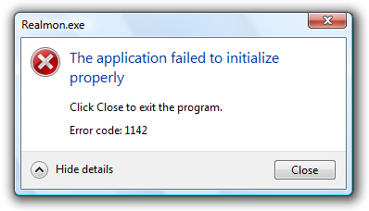
Function parts
Return
Return values have different meanings
Examples:
Error codes
Indices/Handles
Result values
etc
Read documentation carefully to know

Slide 34
Types
You are familiar with the types “int”, “float”, etc.
CProcessing and other libraries will have their own types for ease of use

Slide 35
Some CProcessing Types
CP_Matrix
CP_Color
CP_Image
CP_Sound
CP_Vector

Slide 36
Types
For now, treat these types similar to that of “int” and “float”
Especially when in terms of reading and writing that type.

Slide 37
Types (example)
// Use the CP_Color_Create function to create a variable
CP_Color color1 = CP_Color_Create(255, 40, 100, 255);
// Set the background with color1 (berry red)
CP_Graphics_ClearBackground(color1);

Slide 38
Moving forward
You will be using functions and types from libraries and making your own
Notes:
Students need to have some grasp of how functions work.
This will help ground them in executing the higher level ideas following.

Slide 39
Gamedev Basics
Part I
Intro
Frame
Game Loop
Part II
State machine
Rendering
Input
Movement
interpolation

Slide 40
The problem
#include "Console/Console.h"
#include <Windows.h>
static int bGameIsRunning = 1;
int main()
{
// Game Initialization
[Console initialization here]
// Game Loop
while (bGameIsRunning)
{
// Process Inputs
[Input processing here]
// Update
[Update code here]
// Render
[Rendering code here]
}
// Game Shutdown
[Clean shutdown here]
}
We want
A Start Menu
The Game
A Game Over
We don’t want
Spaghetti code with nested loops
All the code in the Game Loop

Slide 41
Flowchart
Main Menu
Game
GameOver
Start
Program
Exit
Program

Slide 42
Flowchart
Main Menu
ProcessInput()
Update()
Render()
Game
ProcessInput()
Update()
Render()
GameOver
ProcessInput()
Update()
Render()
Start
Program
Exit
Program

Slide 43
Flowchart
Main Menu
ProcessInput()
Update()
Render()
Game
ProcessInput()
Update()
Render()
GameOver
ProcessInput()
Update()
Render()
Start
Program
This is a State
Exit
Program

Slide 44
Cprocessing : Game state machine
Each game state is defined by 3 functions
Init
Update
Exit
Each function has no input parameters and returns void

Slide 45
purposes
Init
Initialize variables
Load assets
Allocate resources
Called once for when state first begins or when state is restarted

Slide 46
purposes
Update
Loops, repeats
Contains everything that is required to generate 1 frame
Does the heavy lifting of the state

Slide 47
purposes
Exit
Called once before leaving current game state
Use it to deallocate allocated resources
Loaded sounds, images, etc
Free dynamic memory allocation

Slide 48
Cprocessing : game state machine
Use the CP_Engine_SetNextGameState function to set the very first game state and to go to another game state

Slide 49
Gamedev Basics
Part I
Intro
Frame
Game Loop
Part II
State machine
Rendering
Input
interpolation

Slide 50

Rendering process

Slide 51
rendering
Just like how the painting process works
Pick a colour, pick a brush
Henceforth, everything will be drawn with that brush and colour

Slide 52
rendering
Function that help you choose colour for shapes and fonts
CP_Settings_Fill

Slide 53
rendering
Pick a colour (CProcessing)
/*Creates a CP_Color object with the parameters in order: Red, Green, Blue, Opacity)*/
/*This is an example of creating a CP_Color object named color1 with green*/
CP_Color color1 = CP_Color_Create(0, 255, 0, 255);
/* This will set the 'fill' with green color */
CP_Settings_Fill(color1);
/* Or you can do both in one step */
CP_Settings_Fill(CP_Color_Create(0, 255, 0, 255));

Slide 54
rendering
We will be drawing every frame
Need to clean out what we drew in the previous frame before drawing the current frame
CProcessing Method : Do this by setting the background colour
CP_Graphics_ClearBackground(CP_Color_Create(0, 0, 0, 255));

Slide 55
Screen coordinate system
0
X
Y

Slide 56
Rendering positions
When drawing shaped objects, do note the point of reference used to represent its position
Center of the shape?
Top-Left corner of the shape?
Somewhere else?

Slide 57
Screen coordinate system
0
X
CP_Settings_RectMode(CP_POSITION_CORNER);
Y

Slide 58
Screen coordinate system
0
X
Y
CP_Settings_RectMode(CP_POSITION_CENTER);

Slide 59
Rendering positions
Cprocessing functions for reference position
CP_Settings_RectMode
CP_Settings_EllipseMode
CP_Settings_ImageMode

Slide 60
Render Objects
Fundamentally, we are drawing triangles.
Triangles are made of 3 vertices (points), and the order of the points determine the triangles facing.

Slide 61
Render Objects
CProcessing simplifies this process by providing functions to draw 3 types of objects:
Shapes (a shape with a colour)
Images (a quad with a texture)
Fonts (text)

Slide 62
Images
CProcessing functions:
CP_Image_Load (Done in Init)
CP_Image_Free (Done in Exit)
CP_Image_Draw (Done in Update)
etc

Slide 63
Shapes
CProcessing functions:
CP_Graphics_DrawRect
CP_Graphics_DrawCircle
etc

Slide 64
Render Process Summary (Update loop)
Clear background
For each object:
Set colour (for font and shapes. No need to set if consecutive shapes and fonts are using the same colour)
Set reference position setting (if it changes for each object)
Draw the object

Slide 65
Gamedev Basics
Part I
Intro
Frame
Game Loop
Part II
State machine
Rendering
Input
interpolation

Slide 66


input

Slide 67
input
Handled by CProcessing
Input checking should be done at the beginning of each frame, before the rest of the simulation

Slide 68
input
CPRocessing helps you get input from various devices:
Mouse
Keyboard
Gamepad

Slide 69
input
For the first project you will need these:
CP_Input_GetMouseX
CP_Input_GetMouseY
CP_Input_GetMouseWorldX
CP_Input_GetMouseWorldY
(The difference lies in the coordinate system they are retrieving mouse position from)

Slide 70
Gamedev Basics
Part I
Intro
Frame
Game Loop
Part II
State machine
Rendering
Input
interpolation

Slide 71
Interpolation
“the insertion of an intermediate value or term into a series by estimating or calculating it from surrounding known values” – Oxford Languages

Slide 72
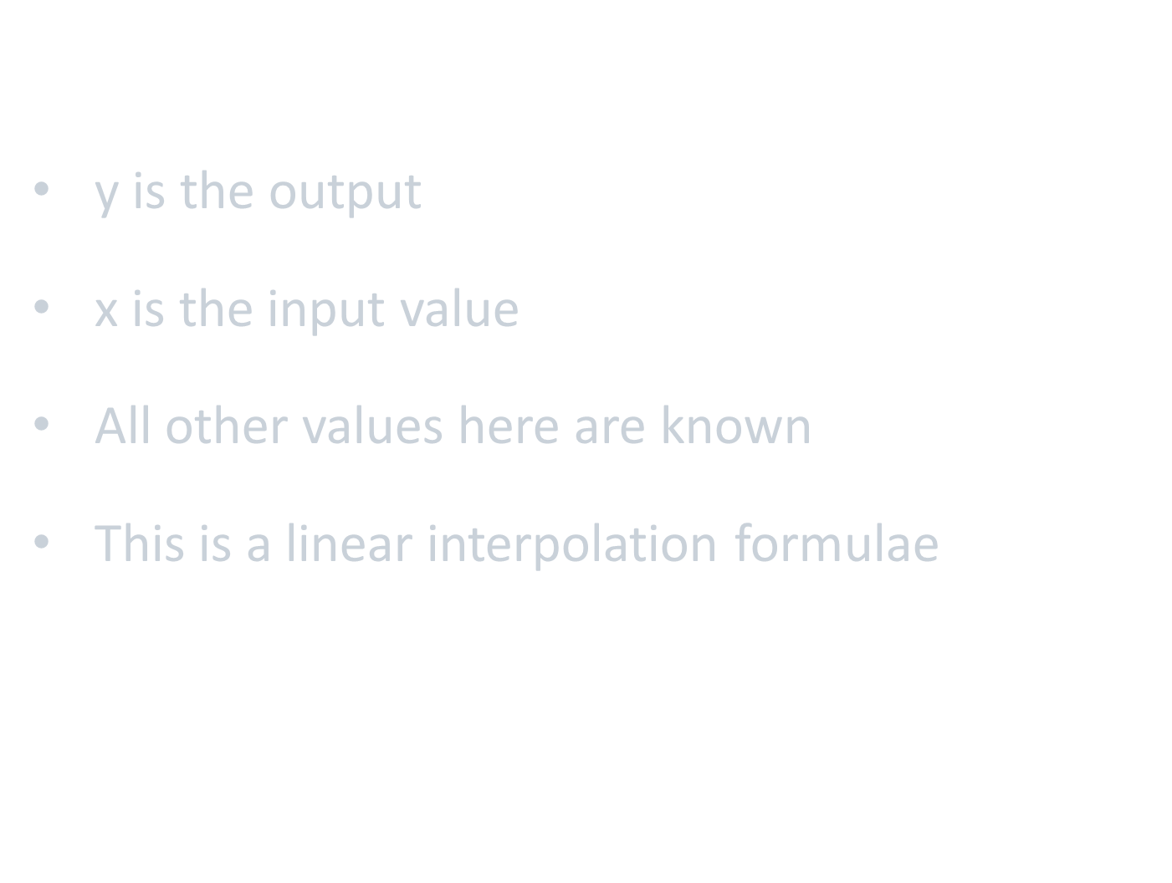
What you are familiar with
$y−y_{1}=\frac{y_{2}−y_{1}}{x_{2}−x_{1}}\left(x−x_{1}\right)$
y is the output
x is the input value
All other values here are known
This is a linear interpolation formulae

Slide 73
For our purpose : Animation
Start point
End point
Time required to get from start to end

Slide 74
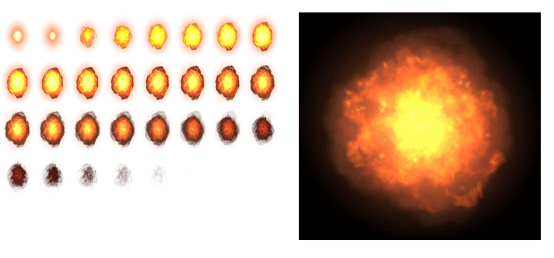
https://gfycat.com/actualglossyfirecrest

Slide 75
We will use time for our interpolation,
if entire animation takes 2 seconds from start to finish and has 10 frames.
If each frame is to be displayed for the same amount of time, which frame do we render 1 second into the animation?

Slide 76
Splash Screen
Accumulate the time elapsed each frame to determine the alpha of your background image
The screen should take a fixed number of seconds to fade in completely
Then the screen will be completely faded out and repeat the fade in process

Slide 77
Splash Screen
CP_System_GetDt
Every frame, we need to decide what to render
So we need to use this function to know how much time has passed since the last frame, since the last time we rendered.

Slide 78
Hints
Accumulate the time elapsed using a variable of type “float”
(if you are accumulating time in terms of seconds or milliseconds)

Slide 79
Hints
For the wrap around effect, notice what the “%” operator for “int” provide:
0%3 == 0
1%3 == 1
2%3 == 2
3%3 == 0
4%3 == 1
5%3 == 2

Slide 80
Thanks!
Any Questions ?
Appointment:
cheng.dingxiang@digipen.edu

